Slide 1
Deep Learning Classification of Video Game Art Images: Doom vs Animal Crossing
National Centre of Scientific Research
"Demokritos“
Author: Alexandros Filios

Slide 2
Table of Contents
01
02
03
04
Introduction
Unveiling the Artistic Essence of "Doom" and "Animal Crossing"
Methodology
Leveraging Deep Learning for Art Style Classification
Implementation
Building Custom CNN and Harnessing VGG Model
Evaluation & Results
Performance Analysis and Insights into Art Style Classification

Slide 3
01
Introduction

Slide 4
Understanding the Problem
Background and Motivation
Scope and Significance
Project Structure
Exploring Art Style Classification
Understand the fundamentals of CNN
Training and comparing different Deep Learning Architectures

Slide 5
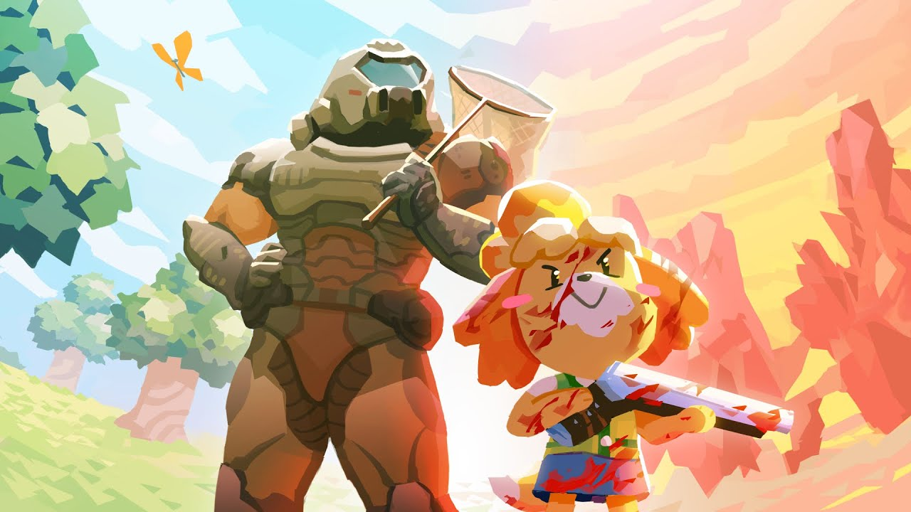
Doom vs Animal Crossing
840 Images
757 Images
Major differences in the art styles

Slide 6
02
Methodology

Slide 7
Methodology
Dataset
CNNs
01
02
Collected from r/doom and r/animalcrossing
, including .csv files
Both a custom CNN and Transfer Learning as well
Training and Evaluation
03
accuracy, loss, and validation accuracy

Slide 8
03
Implementation

Slide 9
Data Processing
Split my data
into 32 batches
Created a batch iterator
Step 1
Step 2
Step 3
Step 4
Resized the Images to 256x256x3(rgb)
Split my dataset into:
Training set: 70%
Valisation set: 20%
Testing set: 10%

Slide 10
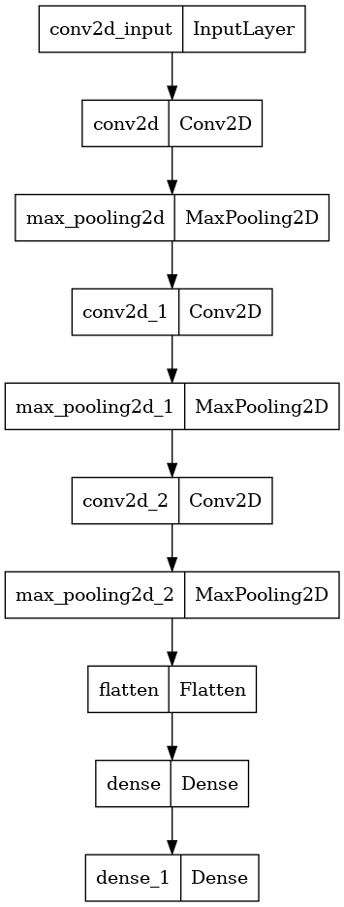
Custom CNN
Sequential Model: Linear stack of layers.
Convolutional Layer: Extracts features from input images using filters.
MaxPooling Layer: Reduces spatial dimensions of feature maps while preserving important features.
Flatten Layer: Converts 2D arrays into a linear vector for connecting to fully connected layers.
Dense Layer: Performs classification based on extracted features.
Adam Optimizer: Adaptive optimizer for efficient training and handling sparse gradients.
Binary Crossentropy: Loss function for minimizing the difference between predicted and true labels.

Slide 11
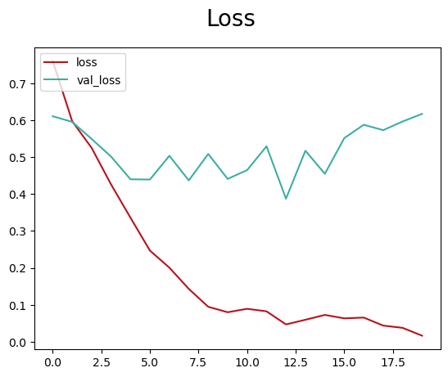
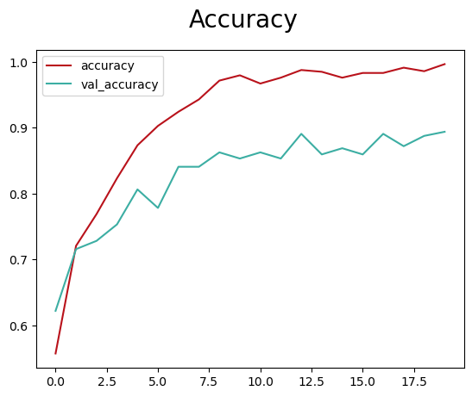
Custom CNN
Training:
Testing:
 | Precision | Recall | Accuracy
 | 0.79 | 0.82 | 0.79

Slide 12
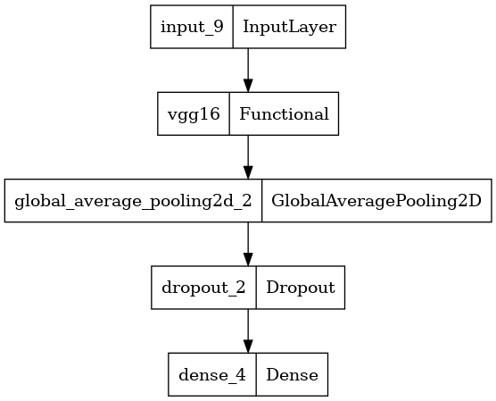
VGG CNN
VGG Architecture: Pre-trained model on ImageNet dataset for image classification.
VGG16 Base Model: Loaded with pre-trained weights, excluding top layers.
Classification Layers: Added global average pooling, dropout, and dense layers for final output.
Fine-Tuning: Unfroze some top layers to adapt model to specific dataset.
Adam Optimizer: Used with adjusted learning rate for efficient model convergence.

Slide 13
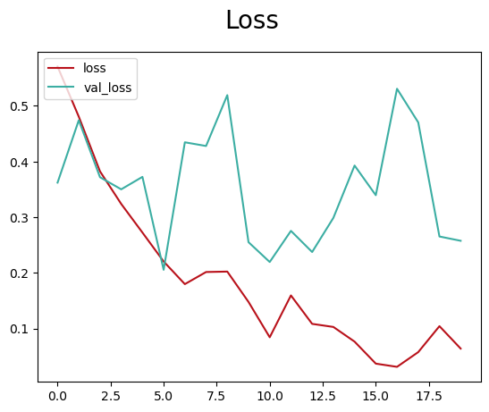
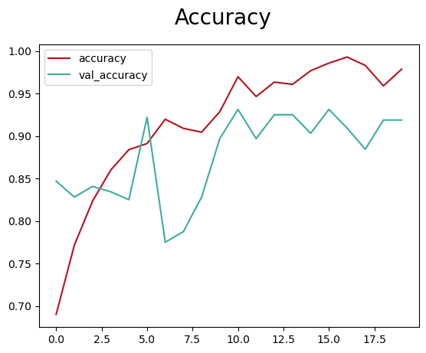
VGG CNN
Training:
Testing:
 | Precision | Recall | Accuracy
 | 0.93 | 0.86 | 0.90

Slide 14
04
Evaluation & Results

Slide 15
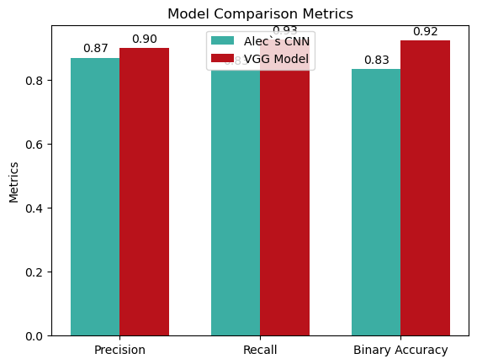
CNN Comparison

Slide 16
Thanks!

